Slide 1
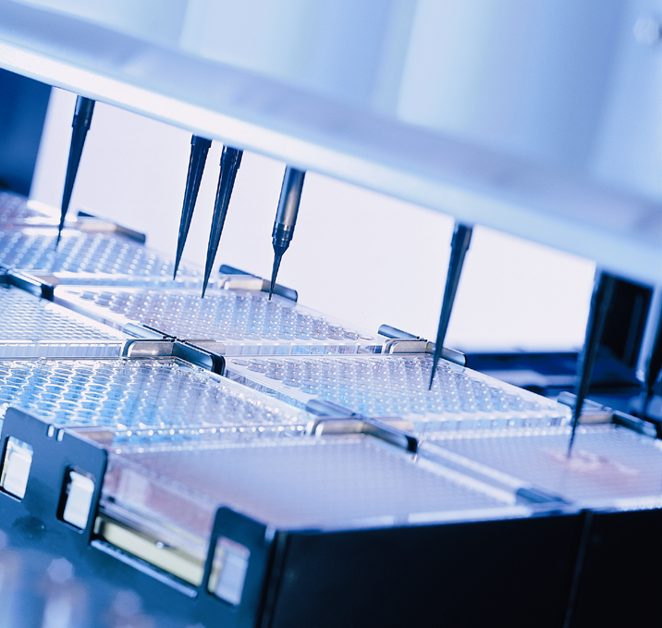
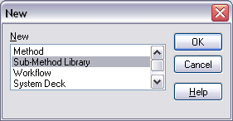
HAMILTON MICROLAB® Vector
Sub-Method Libraries

Slide 2
HAMILTON MICROLAB® Vector
Sub-Method Libraries
Can be used in any method
Are not associated with any particular deck layout
Are written in the regular graphical method editor
Can have one or more commands that would be available in a regular method
Can‘t be run on their own
Can be exported and imported
Vector DB 4.1

Slide 3
Creating a Sub-Method Library
In the Method Editor, with no other methods open, click the New icon to get this dialog.
Select Sub-Method Library and click OK.

Slide 4
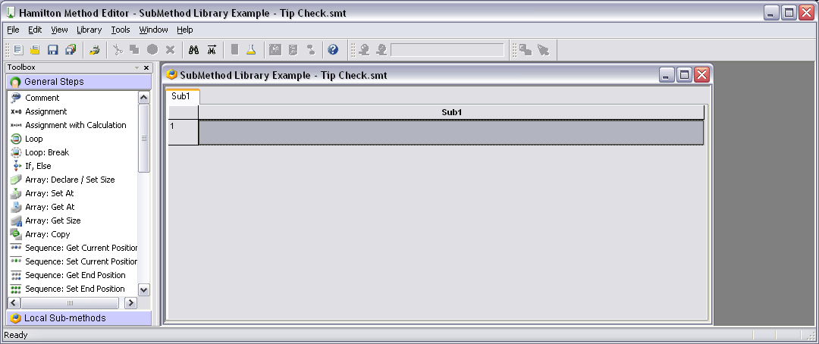
Creating a Sub-Method Library
You will get this view. The Sub-Method Library will have one submethod tab, called Sub1.

Slide 5
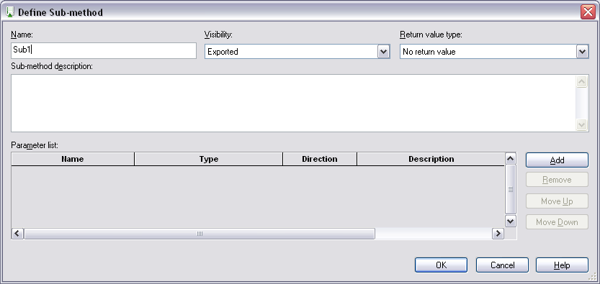
Creating a Sub-Method Library
Right-click on the Sub1 tab and select Edit. You will get this dialog.

Slide 6
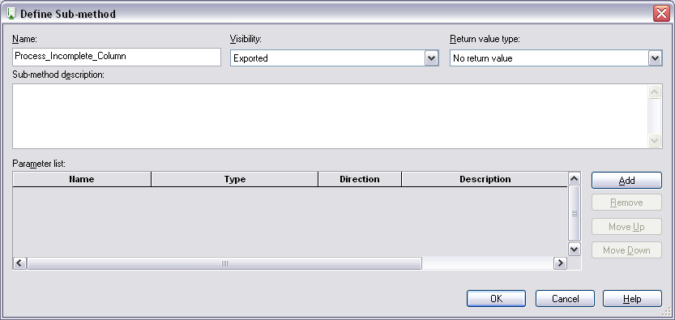
Creating a Sub-Method Library
Give your sub-method a name. This name will be the name of a command visible after you include this Sub-Method Library into a regular method.

Slide 7
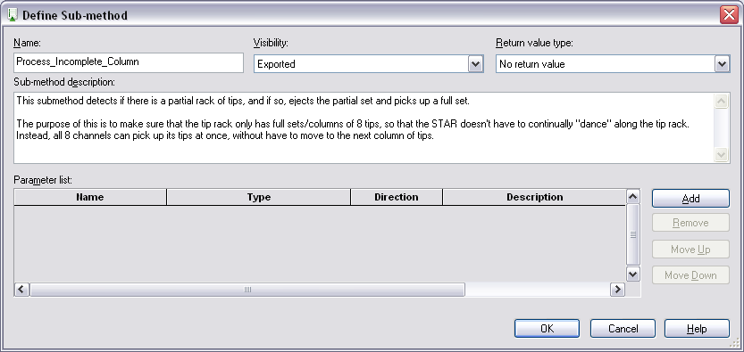
Creating a Sub-Method Library
Give your sub-method a description (optional, but recommended).

Slide 8
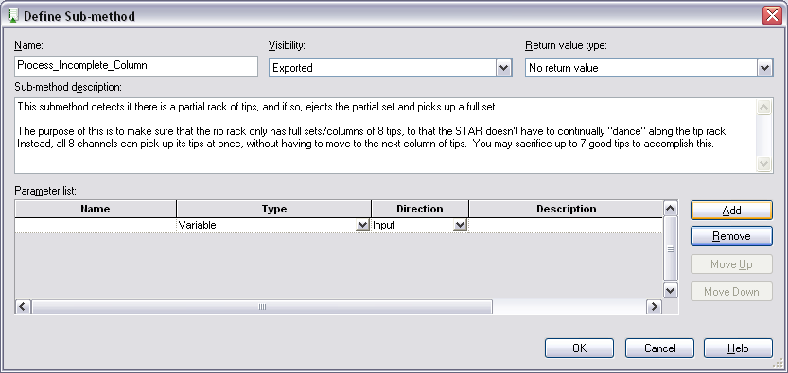
Creating a Sub-Method Library
Next, click Add to create an entry in the Parameter list.

Slide 9
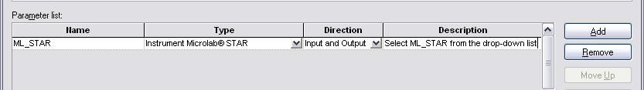
Creating a Sub-Method Library
If this Sub-Method Library is going to be used to do something with the STAR, then you need a way to link it to a deck layout eventually.
To do this, type in ML_STAR in the Name field.
Select Instrument Microlab STAR / STARlet / STARplus from the Type list.
Type in a description for this parameter, like below.

Slide 10
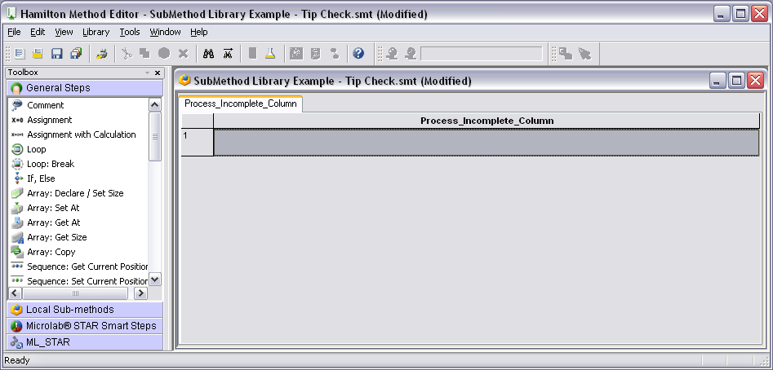
Creating a Sub-Method Library
When you click OK to close this dialog, the ML_STAR commands and Smart Steps will now appear in the command toolbox.

Slide 11
Creating a Sub-Method Library
Now think about what you want to do with that submethod within your Sub-Method Library.
To make your Sub-Method Library truly universal, you will have to add parameters for sequences and variables in your submethod.
In this example, we will need parameters for:
Tip pickup sequence
Tip eject sequence

Slide 12
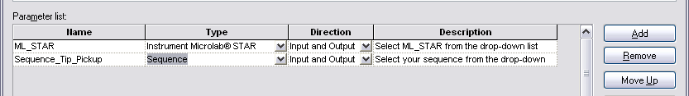
Creating a Sub-Method Library
Again, right-click on your submethod tab, and select Edit.
Click Add to add another line to the Parameter list.
Assign a name for your Tip Pickup sequence parameter.
Select Sequence from the Type list.
Provide a description (optional, but recommended)

Slide 13
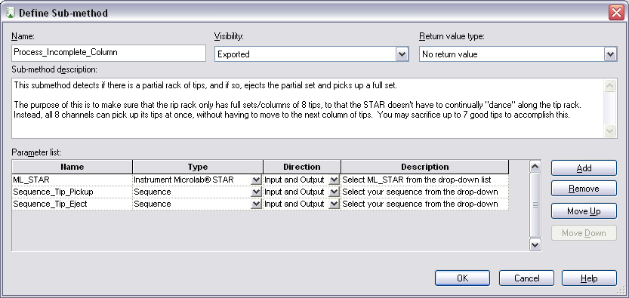
Creating a Sub-Method Library
Do the same thing for the Tip Eject sequence.

Slide 14
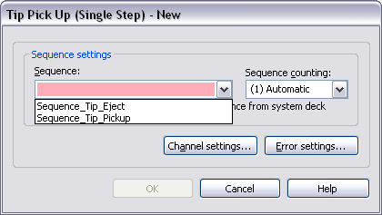
Creating a Sub-Method Library
Now build your submethod. In the instrument commands you use, you will see your Sequence Parameters in the drop-down lists.

Slide 15
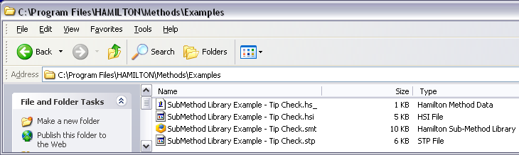
Creating a Sub-Method Library
When you are done with the submethod(s) in your Sub-Method Library, be sure click Save. Your Sub-method library is saved with a .smt extension.
If you use Windows Explorer, you can see that four associated files were created.

Slide 16
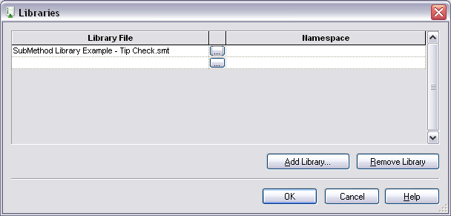
Using Your Sub-Method Library
Create a new Method in the usual way. Define your deck layout. Then bring your Sub-Method Library into your method the same way you‘d bring in any of the regular libraries.

Slide 17
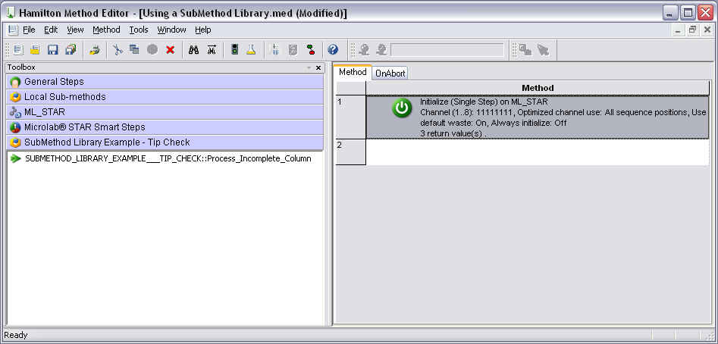
Using Your Sub-Method Library
Now your Sub-Method Library will show up in your command Toolbox. The submethod within your Library shows up as a command.

Slide 18
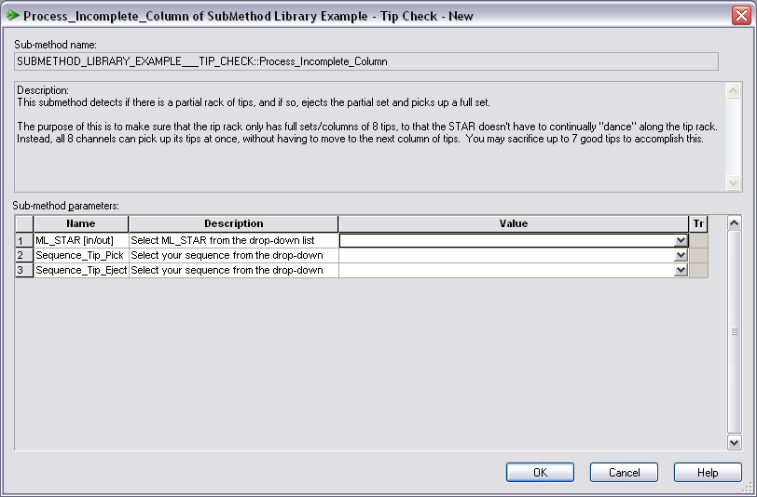
Using Your Sub-Method Library
Drag that command into your regular method. This type of dialog box will appear. Select values from the lists.

Slide 19
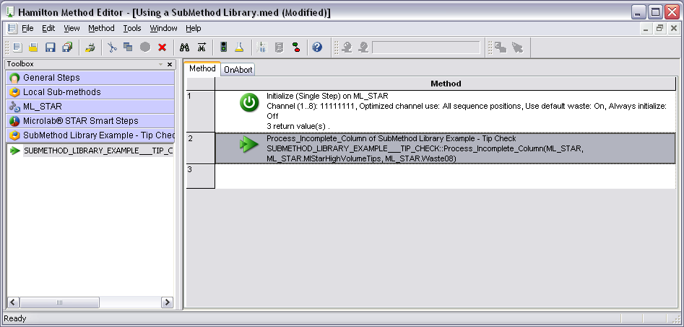
Using Your Sub-Method Library
Once you click OK to close the dialog, your command will appear in the method, with your parameters showing.

Slide 20
Changing Your Sub-Method Library
Editing your Sub-Method Library:
If you just add/delete/change commands within the existing submethods, then the changes will be incorporated the next time your regular method is run.
If you add or delete a submethod, then you have to Remove and then re-Add your Library to your method. You do not have to delete the associated commands within your method before Removing the Library.

Slide 21
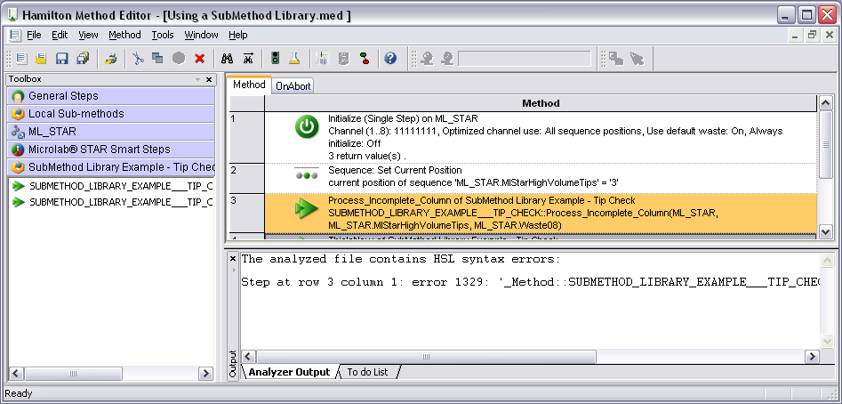
Changing Your Sub-Method Library
Editing your Sub-Method Library:
3. If you add/delete/change parameters within the submethod(s) of your Library, then you need to Remove/ReAdd your Library and then open each command within your regular method to make sure it has the correct settings. Otherwise, you will get syntax errors (shown in color below).

Slide 22
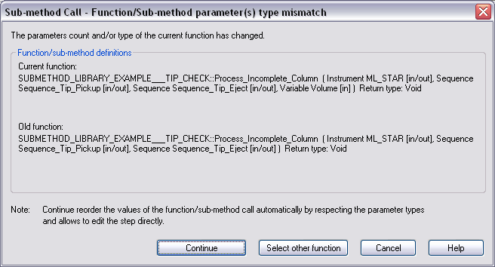
Changing Your Sub-Method Library
When you open your commands to correct them, you will get a Type Mismatch dialog like this. Click Continue.

Slide 23
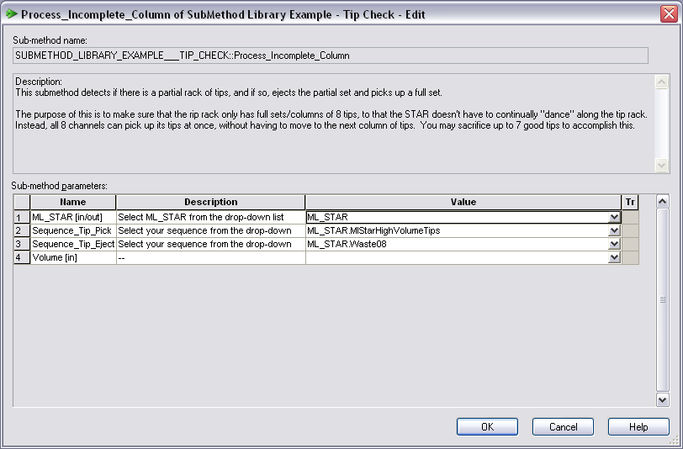
Changing Your Sub-Method Library
Fill in the value for the new parameter and click OK.

Slide 24
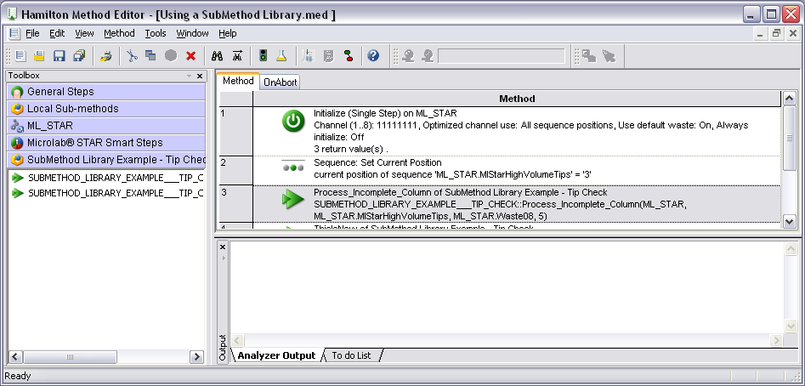
Changing Your Sub-Method Library
Finally, save your method to clear the Analyzer Output

Slide 25
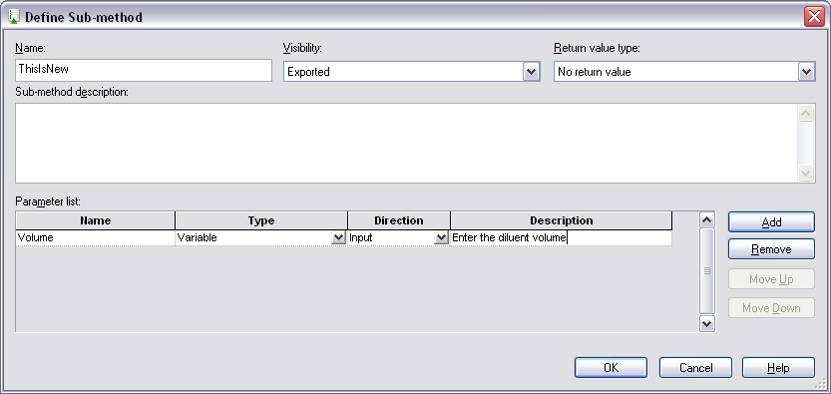

Using Variables as Parameters
If you use variables in your SubMethod Library, you need to define the Direction.

Slide 26
Using Variables as Parameters
If you select Input, then you can just enter a value when bringing the command into your regular method.

Slide 27
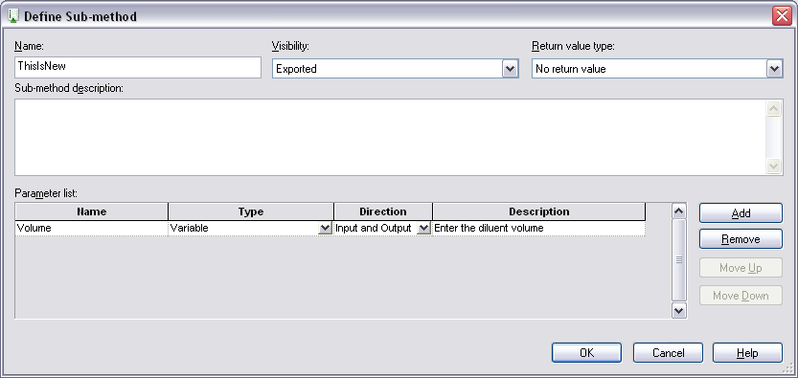
Using Variables as Parameters
If you select Input and Output, then you must define an associate variable within your regular method and use that variable as the parameter value.

Slide 28
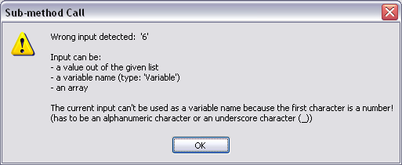
Using Variables as Parameters
If you select Input and Output, and you try to enter a number or a string directly into the command parameter box in your regular method, you will get a Wrong Input Detected error.

Slide 29
Using Variables as Parameters
If you select Output as the Direction, you will also need to use a variable for that parameter within your regular method, or you will get the same error.

Slide 30
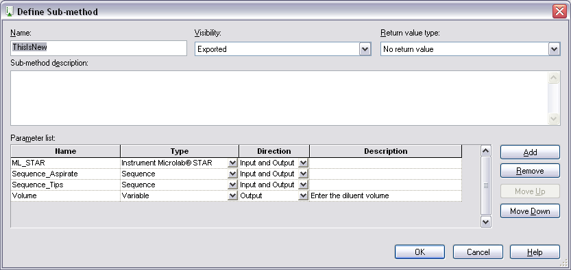
What are those other fields?
Visibility: For submethods within a Sub-Method Library, this is set to Exported. For submethods within a regular method, this is set to Not Exported.

Slide 31
What are those other fields?
Use the Move Up and Move Down buttons to change the order of your parameters.

Slide 32
What are those other fields?
Return Value Type: No return value is the default. If you instead select Variable as the return type, you need to include the General step Return at the end of your submethod.

Slide 33
More on Sub-Method Libraries
When creating a new Sub-Method Library, be careful about having other methods open.
In some cases, the instrument commands in the Sub-Method Library will allow you to select sequences that are part of the open deck layout.
This may lead to mistakes and prevent universality of the Library.

Slide 34
Modular Approach
Complex processes can be broken down into sub-method libraries.
MainMethod.med
Main_SMT.smt
Utility smts
Worklist.xls
Worklist.smt
Function1.smt
(Loading)
Function2.smt
(Sample Prep)
Function3.smt
(Transport)
Load samples
Load reagents
Add Reagents
Serial Dilution
iSWAP move
Gripper move

Slide 35
Modular Approach
Benefits of the Modular Approach
Much less Analyzer time during editing
Somewhat less Analyzer time during run loading
Several programmers can work at once (each on his own modules)
Each module can be validated separately
Changes can be made to a module without affecting the main method
MainMethod.med
Main_SMT.smt
Worklist.xls
Function1.smt
(Loading)
Function2.smt
(Sample Prep)
Function3.smt
(Transport)
Load samples
Load reagents
Add Reagents
Serial Dilution

Slide 36
Modular Approach
Strategy
Chart out the process
Use variables for as many parameters as possible
Employ a worklist to store values for those variables
Have one module (smt) that just reads the worklist
The worklist can be easily changed without touching its related modules
The main smt calls the other sub-main smts which call the third-layer smts.
Use Helper or Utility smts for common actions

